Slide 1
Project
Sales and Shipping Dashboard
Description – The Sales and Shipping Dashboard project aims to streamline and optimize the process of tracking sales and managing shipping logistics using Microsoft Excel. This dashboard serves as a centralized platform where users can visualize, analyze, and manage various aspects of their sales and shipping operations.

Slide 2
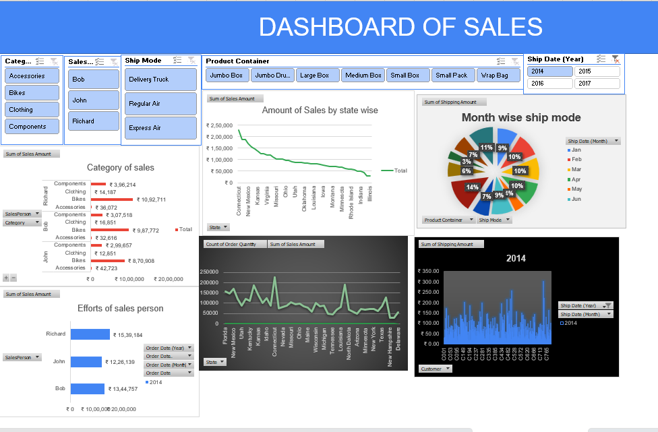
OVERVIEW :-

Slide 3
INSIGHT 1:-State wise Sales Amount

Slide 4
INSIGHTS 2:-Product Category of Sales

Slide 5
INSIGHTS 3:-Ship mode according to Month

Slide 6
INSIGHTS 4:-Efforts by Salesmen

Slide 7
INSIGHTS 5:-Order Quantity by State

Slide 8
INSIGHTS 6:-Shipping amount by Customer

Slide 9
THANK YOU

